Slide 1

FAIM Python Workshop II – Data Handling and Analysis
27 August 2019 | benjamin.titze@fmi.ch

Slide 2
Outline
Prerequisites: Python 3.6, Jupyter Notebook, numpy, scipy, pandas, matplotlib
Could you run the code from pre-check.py inside your Jupyter Notebook?
How Python handles data
Basic data types
Immutable and mutable objects
Passing by reference vs passing by value
Brief intros to the core Python data science libraries
Processing and analysing data with NumPy, SciPy and pandas
Visualization with matplotlib
Working with an example dataset
Duration: ~90 min

Slide 3
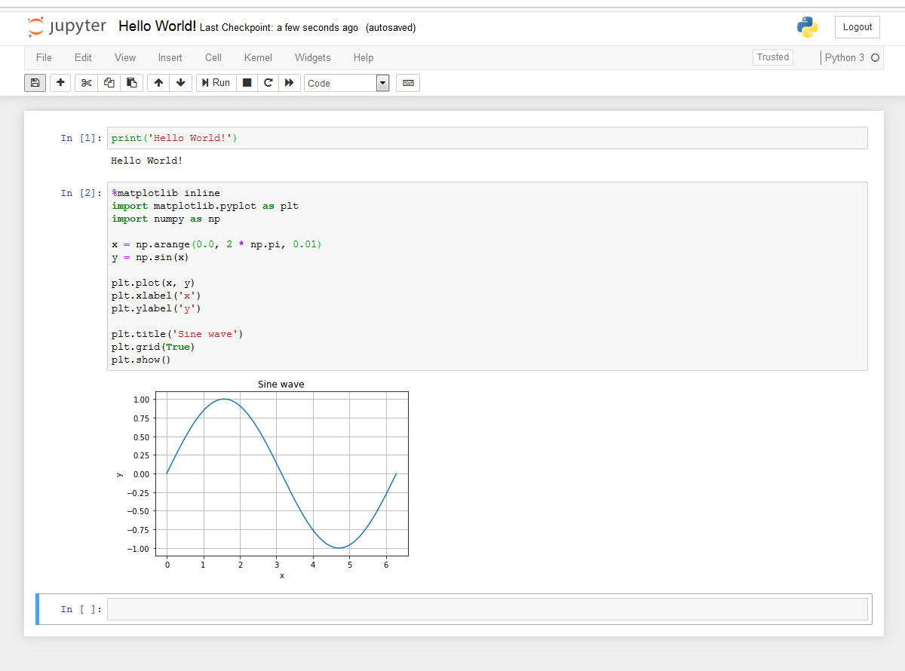

Jupyter Notebook
Browser-based interactive programming environment (previously IPython Notebook)
Named after the core languages supported:
Julia, Python, and R.
A common tool for data science / scientific computing in both academia and industry.
Run from command line: jupyter notebook
or launch via Anaconda navigator

Slide 4
Start up Jupyter Notebook and open a new Python 3 notebook!

Slide 5
Overview: Python data types
int – Integer (whole numbers, like 253, -12)
float – floating-point numbers such as -243.1998
bool – Boolean, named after mathematician George Boole: True or False
str – String of characters, for example:'FMI', '世界', '2 tables'
The above are Python’s most basic immutable built-in types.
tuple – an immutable sequence of objects: ('a string', 89, False)
The following are mutable:
list – a sequence of objects, e.g., [5, 6, 7, 1] or [True, 'true']
dict – a ‘dictionary’, an unordered mapping of keys to values: {'name': 'Anne', 'age': 29}
set – an unordered set of distinct objects: ('cow', 'dog', 'horse')

Slide 6
Fundamental concepts
In Python, everything is an object.
Use type() to return the type of any object. You will notice that even the basic data types are classes, for example: <class: 'int'> (in Jupyter Notebook, only int is shown)
Use id() to return the ‘identity’ of an object, which is its location in memory (for CPython). It’s unique and constant during an object’s lifetime.
Mutable objects can be changed (= modified in place) and will remain pointed to a fixed location in memory.
Immutable objects cannot be changed, only reassigned to new values. If reassigned, they point to a new location in memory.
Let’s look at concrete examples in our Jupyter Notebook!
→ datatypes.ipynb

Slide 7
Passing by reference vs passing by value
When you call a function in Python, pay attention to whether you’re passing arguments that are mutable or immutable.
Passing a mutable object, for example a dictionary: You are passing a reference to the object. If you change it inside the function, the object will also be changed outside the function.
If you pass an immutable object, for example a string: In this case, the function can only use the value of this string. If the object is changed inside the function, it has no effect on the outside scope.
Examples
→ datatypes.ipynb

Slide 8
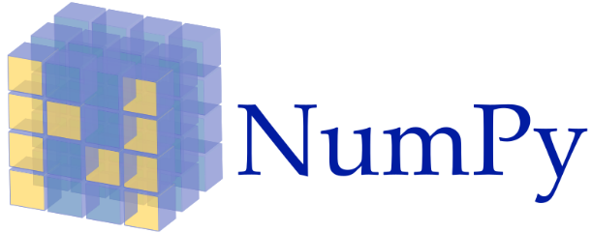

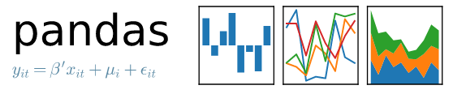

Python’s data science ecosystem: the core libraries
(pronounced Num Pie)
A library for fast manipulation of multidimensional numerical data. The basic type ndarray is a multidimensional array with zero-based indexing
→ numpy-intro.ipynb
(pronounced Sigh Pie)
A scientific computing library with various modules for numerical integration, linear algebra, image processing, Fourier transforms, signal processing, statistical functions…
Builds upon numpy arrays.
→ scipy-intro.ipynb
pandas – panel data structures
Various tools to work with structured data sets (SQL/Excel functionality). Useful for loading and manipulating tables, for example measurement results. The basic types are DataFrame and Series.
→ pandas-intro.ipynb
MATLAB-like visualization support through the pyplot module: 2D and 3D plots, histograms, multipanel figures; works in Jupyter notebooks.
→ matplotlib-intro.ipynb

Slide 9
Conventional import abbreviations
import numpy as np
import pandas as pd
import matplotlib.pyplot as plt
For scipy, just import the module you need, for example:
from scipy import fftpack
or
import scipy.fftpack
Please make sure these imports work. Install the libraries if necessary.

Slide 10
Brief introductions to NumPy, SciPy, pandas and matplotlib,
+ exercise with example dataset
→ Jupyter Notebook

Slide 11
Load this dataset with pandas and explore it:
movies_dataset.csv
import pandas as pd
df = pd.read_csv(…)
df.head(…)
…

